Slide 1

Data Structures (15B11CI311) Odd Semester 2021
3rd Semester , Computer Science and Engineering
Jaypee Institute Of Information Technology (JIIT), Noida

Slide 2
Outline
Recursion
Removal of recursion using stack

Slide 3
Recursion
The process of solving a problem by reducing it to smaller versions of itself is called recursion. Recursion is a very powerful way to solve certain problems for which the solution would otherwise be very complicated.
Formally
Recursive definition: A definition in which something is defined in terms of a smallerversion of itself.
1. Every recursive definition must have one (or more) base cases.
2. The general case must eventually be reduced to a base case.
3. The base case stops the recursion.
Recursive Algorithm : An algorithm that finds the solution to a given problem by reducing the problem to smaller versions of itself is called a recursive algorithm. The recursive algorithm must have one or more base cases, and the general solution must eventually be reduced to a base case.

Slide 4
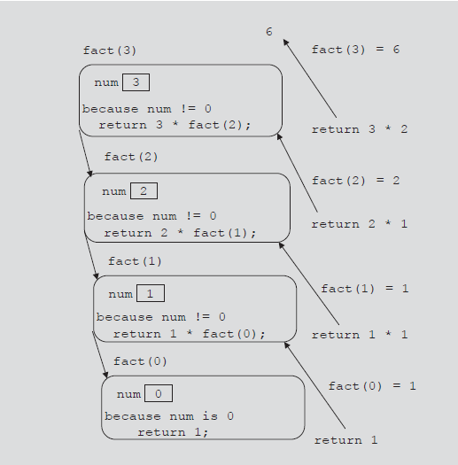
Example : Consider the recursive function that implements the factorial function.
int fact(int num)
{
if (num == 0)
return 1;
else
return num * fact(num - 1);
}
To trace fact (3)

Slide 5

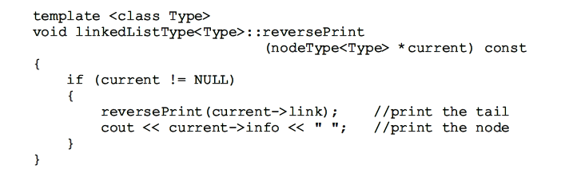
Steps to design a recursive function
1. Understand the problem requirements.
2. Determine the limiting conditions. For example, for a list, the limiting condition is the number of elements in the list.
3. Identify the base cases and provide a direct solution to each base case.
4. Identify the general cases and provide a solution to each general case in terms of smaller versions of itself.
Example : Print a Linked List in Reverse Order
Algorithm :
Base Case: List is empty:
no action
General Case: List is nonempty
1. Print the tail
2. Print the element

Slide 6
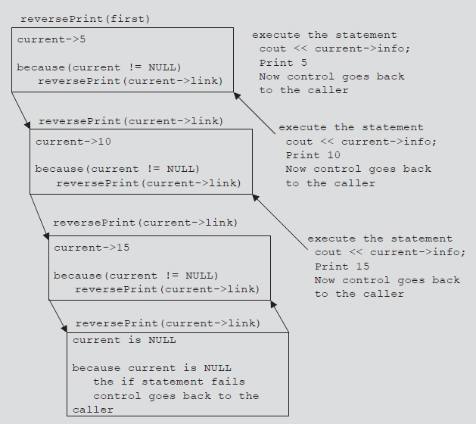
Consider the statement
reversePrint(first);
where first is a pointer of type nodeType<Type>.

Slide 7
Drawbacks of Recursion
Recursion consumes stack space. Every recursive method call produces a new instance of the method, one with a new set of local variables. The total stack space used depends upon the level of nesting of the recursion process, and the number of local variables and parameters.

Slide 8
Removal of recursion using Stack
1) A stack for each parameter, variable, (Label).
2) A variable to hold the return value.
3) if the stop condition is reached, check whether the stack is empty.
4) If the stack is not empty, pop() and jump to the appropriate label.
5) If the stack is empty, return the result.
Example 1:
L2: r = r * n; } else { r = 1; }
if (stack is not empty) { n = pop(); goto L2; } else { return r; } }
int factorial(int n ) { new a stack P; L1: If (n > 1) { push to stack P (n); n = n - 1; goto L1;

Slide 9
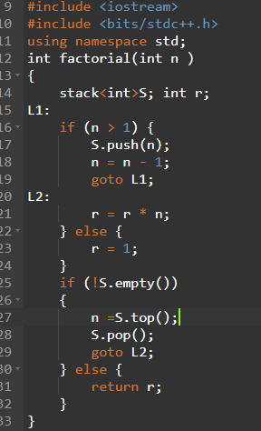
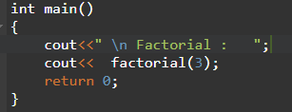

Output

Slide 10

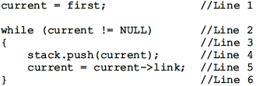

Removing Recursion: Nonrecursive Algorithm to Print a Linked List Backward

Slide 11
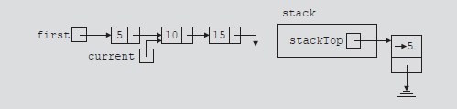
Because current is not NULL, the statements in Lines 4 and 5 execute.

Slide 12
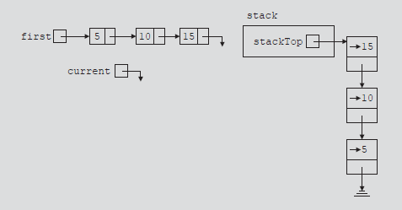
statements in Lines 4 and 5 execute until current becomes NULL. When current is NULL,

Slide 13
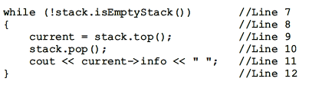
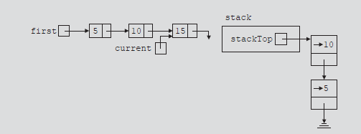
Because current is NULL, the loop condition evaluates to false and the while loop, in Line 2, terminates. it follows that a pointer to each node in the linked list is saved in the stack.
The top element of the stack contains a pointer to the last node in the list, and so on

Slide 14
References
https://www.hackerearth.com/practice/notes/stacks-and-queues/
https://www.softwaretestinghelp.com/stacks-and-queues-in-stl/
Data structures using C++ by D.S Malik

